Slide 1
A Matrix-Based Implicit Prior for Joint Demosaicing and Super-Resolution Algorithm
Final Review
Guided by: Presented by:
W. Jino Hans C. Sneha (312213106095) Assistant Professor C. Sreenithy (312213106097)

Slide 2
Objective
To implement joint demosaicing and super-resolution for colour images.
To perform demosaicing of missing colour components using interpolation algorithm.
To super-resolute RGB colour images obtained from Bayer image.
To learn the image level information between colour class using efficient matrix based priors.

Slide 3
Problem analysis
Why Demosaicing?
Digital cameras in consumer electronics exploit a single image sensor, overlaid with a colour ﬁlter array (CFA), to acquire colour images.
Only one of the three primary colour components (i.e., R, G, or B) is recorded at each pixel location by the sensor.
Why Super Resolution?
Need for high resolution images in various fields like medical imaging for diagnosis, surveillance and satellite imaging applications(CARTOSAT),
Limited range of CCD sensors

Slide 4
Software/Hardware Tools
MATLAB R2015a
McM Image Database

Slide 5
Literature Survey
Super Resolution
A Super-Resolution Algorithm Using Linear Regression Based on Image Self-Similarity
Shen-Chuan Tai et. al(2016)
Joint Super Resolution and Demosaicing
Multi-frame Demosaicing And Super Resolution Of Colour Images
Milanfar et.al(2006)
Image Demosaicing by Non-local Similarity and Local Correlation
Wang Guo-gang et.al(2012)
Joint Multi-Frame Demosaicing And Super-Resolution With Artificial Neural Networks
Theodor Heinze et.al(2012)
Example-based super-resolution via social images
Yi Tang et. al(2014)
Demosaicing
Super-Resolution from a Single Image
Daniel Glasner et. al(2009)
Bayer Demosaicing With Polynomial Interpolation
Jiaji Wu et.al (2016)
An Demosaicing Algorithm Based on Edges
Tian et.al (2015

Slide 6
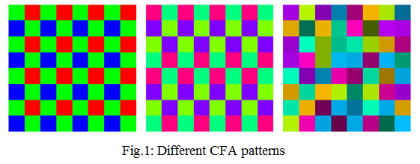
Colour Filter Array (CFA) and Bayer Pattern
The arrangement of the colour components on the mosaiced image is determined by the selected CFA.
In a Bayer Filter, for each 2×2 set of pixels, two diagonally opposed pixels have green filters, and the other two have red and blue filters.
The green is sampled twice with respect to the red and the blue, to exploit the higher sensibility of the human eye to the green wavelength.

Slide 7
Demosaicing
Estimates the missing colour components at each pixel location to restore a full-colour RGB image.
Method is called CFA Interpolation or Demosaicing.
Assumed that colour ratios and colour differences are constant over small regions- colour ratio and colour difference model.
Improper interpolation of neighboring pixel values- false colours and zipper effect.

Slide 8
Colour ratio model
Based on the assumption of uniformity within an image area under consideration.
Fails near edge transitions - both the spectral and spatial correlation characteristics of the image vary significantly.
Colour difference model
Based on assumption that all colour bands have spectral correlations and similar image structures such as textures and edges.
Many methods utilize the colour difference model, i.e., red-green and blue-green.
Colour difference plane is smoother than the R/B plane.

Slide 9
Proposed method
Three steps:
i) New calculation of gradients
ii) Edge classiﬁcation based on colour differences and gradient directions
iii) Reﬁnement stage using a weighted sum strategy for artefacts reduction

Slide 10
Block Diagram

Slide 11
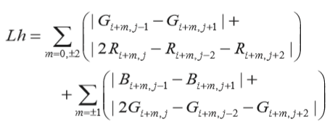
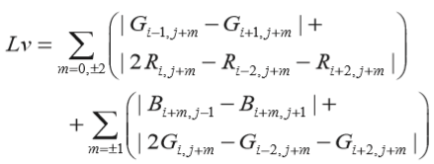
Demosaicing Process
Step 1. Calculating edge information based on CFA
Lh and Lv - two different gradients of image information at pixel (i, j).
Helps in interpolating colour information based on interdependency between colour channels in image

Slide 12
Greater gradient along horizontal direction with respect to pixel (i,j)
Lh > Lv
Unknown color intensity at pixel (i,j) calculated using known color information along vertical direction at the pixel
Greater gradient along vertical direction with respect to pixel(i,j)
Lv > Lh
Unknown color intensity at pixel (i,j) calculated using known color information along horizontal direction at the pixel

Slide 13
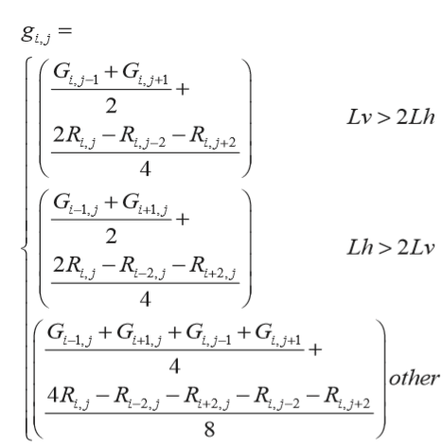
Step 2. Interpolating unknown green intensity
Local edge information is used in the interpolating missing green component.
Lv > 2Lh (or) Lh > 2Lv means significant gradient along that direction.
Else small gradient change (or) a smooth local region in image.

Slide 14
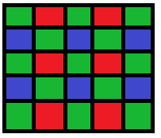
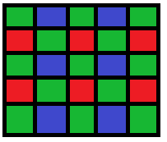
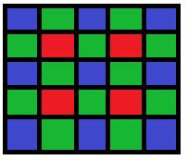
Step 3. Interpolating other colour pixels
Interpolating red intensity at green pixel point in GR and GB line
Interpolating unknown red intensity at blue pixel point

Slide 15
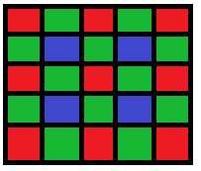
Interpolating blue intensity at green pixel point in GR and GB line
Interpolating unknown blue intensity at red pixel point

Slide 16
Super-resolution
Super-resolution(SR) algorithms obtain high-resolution images from a collection of low resolution photographic images
These techniques involve finding the high frequency components.
This is useful for removing the degradations caused by the imaging process of the low-resolution camera.
The relative association between the high resolution and low resolution images must then be learned.

Slide 17
Regression based SR algorithms
Regression is the process of estimating the relationship existing between variables.
It targets at establishing a universal relationship between low resolution and high resolution image pairs in the training set.
A least mean square error condition is considered.
The data is fitted by a method of successive approximations where the sum of squares must be minimized by an iterative procedure.

Slide 18
Image Patch Vectorisation
Image vectorisation is the process of converting images into a vector graphic.
Computers understand images only as arrays of pixel values, limiting the operations that can be done to manipulate the pixels.
The vectorisation of images however suffers a drawback when it leads to the loss of image level information due to structural incongruity.
Matrix operations have been proved to be ideal as they retain important image level information.
It is possible to design a patch-to-patch super-resolution algorithm uisng matrices.

Slide 19
Proposed method
We are going to implement a example-based super-resolution algorithm to obtain the implicit prior.
Regression analysis is done to obtain a relation between the corresponding patches in low resolution and high resolution image from the training set.
Matrix-based regression is used instead of vectors to preserve structural information.

Slide 20
Block Diagram

Slide 21
Matrix Value Operator
Image patch-pair is denoted as 𝑠 = (𝑥, 𝑦) ∈
Each image pair potentially defines a linear operator M of size (p x p) which satisfies,
y = M · x
For a full rank matrix,
M = y x⁻¹
The matrix value operator M depends on the full rank condition of its image patch-pairs to formulate the matrix inverse.
For rank deficient matrices, computation of inverse is not stable.
To accommodate rank deficient patch-pairs, matrix inverse is computed by singular value decomposition.

Slide 22
Training Phase
High quality image set .
These high-resolution examples are then down-scaled by a scale factor s.
Corresponding low-resolution image set .
The LR images are up-scaled to the size of the HR example images (m x n) using interpolation and is denoted by .
Thus, the set of images in denote the training image pairs.

Slide 23
Training Phase cont.
The optimal matrix-value operator is learned from the training set S_{n} using the least square regression model,
Simplifying the above model,
where = , = and K₂ =
The optimal matrix-value operator M* should satisfy the local minima condition.

Slide 24
Training Phase cont.
Therefore the optimal Matrix-value operator is given by
Due to the rank deficiency obstacle, we compute the inverse of the auxiliary matrix K ₂ ⁻¹ by factorizing it with singular value decomposition (SVD).
Here , where U and V are orthogonal matrices and Σ is a diagonal matrix with singular values.
Thus,
The optimal matrix-value operator shown explicitly represents the image-level correspondence between the LR and HR image patch-pairs.

Slide 25
Reconstruction Phase
Makes use of the optimum matrix-value regression operator learned from the previous step to super-resolve a LR image.
Let the test image be T_{lr}.
Non-overlapping image patches of size (p x p) are extracted from the interpolated test image.
Collection of low-resolution patches is represented as
Optimum matrix-value regression operator is applied as
t _{hr} = M * t _{lr}
The super-resolved test image patches are merged together to form the super-resolved high-resolution image T _{hr}.

Slide 26
Image Quality Assessment Metrics
Peak signal-to-noise ratio (PSNR)
- Ratio between the maximum possible power of a signal and the power of corrupting noise that affects the fidelity of its representation.
Mean Squared Error(MSE)
- Average of the squares of the errors or deviations, the difference between the estimator and what is estimated.
Structural Similarity Index(SSIM) & Feature Similarity Index(FSIM)
SSIM index is a method for measuring the similarity between two images based on an initial uncompressed or distortion-free image as reference.
FSIM is a similarity measurement based on comparison between image features like gray levels, texture with the coefficients in the Fourier, structure, etc.

Slide 27
(a) #1 (b) #5 (c) #11
(d) #17 (e) #18
Fig: Few images from the McM dataset

Slide 28
Demosaicing Results
(a) (b) (c) (e)
Fig: (a) is experimental original image, (b) to (d) correspond to reconstructed images of four different methods –bilinear interpolation, edge-corrected bilinear interpolation and proposed method .

Slide 29
Metrics
Comparison of output PSNR/MSE for different
demosaicing algorithms
Comparison of output SSIM/FSIM for different
demosaicing algorithms

Slide 30
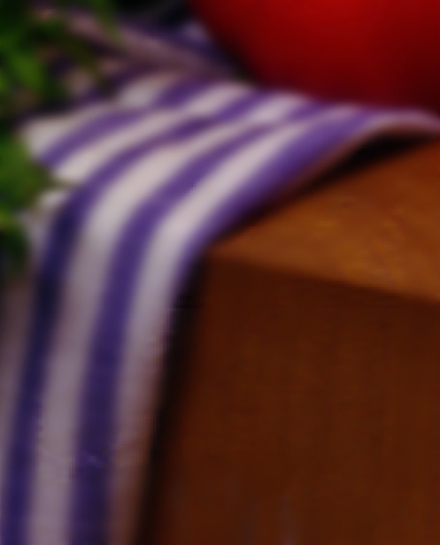
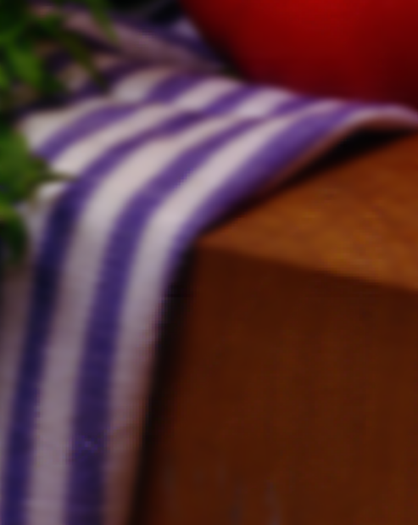
Super-resolution Results
(a) (b) (c) (d) (e)
Fig: Variation of test image for different SR algorithms (a) Test LR image (b)Yang et.al
(c) Kim et.al (d) Bicubic Interpolation (e)Proposed method

Slide 31
Metrics
Test Image | Yang et al. | Kim et al. | Bicubic | Proposed
#1 | 29.21/36.140 | 30.08/38.429 | 28.51/36.678 | 32.232/38.893
#5 | 35.203/15.116 | 36.103/15.07 | 35.396/15.145 | 36.190/15.633
#11 | 36.015/9.936 | 36.964/10.900 | 35.348/9.998 | 37.750/10.914
#17 | 33.558/34.124 | 33.194/34.330 | 33.589/33.450 | 34.860/34.860
#18 | 31.459/62.913 | 32.281/62.030 | 30.21/62.551 | 30.124/63.186
Comparison of output PSNR/MSE for different SR algorithms

Slide 32
Metrics
Test Image | Yang et al. | Kim et al. | Bicubic | Proposed
#1 | 0.9766/0.9754 | 0.9801/0.9787 | 0.9825/0.9748 | 0.9875/0.9817
#5 | 0.9372/0.9801 | 0.9785/0.9782 | 0.9761/0.9833 | 0.9884/0.9898
#11 | 0.9365/0.9766 | 0.9847/0.9815 | 0.9893/0.9834 | 0.9906/0.9875
#17 | 0.9583/0.9750 | 0.9735/0.9737 | 0.9851/0.9769 | 0.9863/0.9808
#18 | 0.9653/0.9699 | 0.9788/0.9712 | 0.9457/0.9535 | 0.9685/0.9562
Comparison of output SSIM/FSIM for different SR algorithms.

Slide 33
Conclusion
An image reconstruction algorithm is proposed to reconstruct mosaics based on an improved interpolating method and is followed with an image super-resolution algorithm.
Demosaicing algorithm yielded better results qualitatively and quantitatively compared to bilinear interpolation and edge corrected bilinear
Proposed example based super-resolution algorithm utilising matrix based implicit prior showed better PSNR and structural similarity results than state of the art algorithms
The combined framework proved to be efficient than carrying out each of them seperately

Slide 34
Future Work
The demosaicing of images with weak spectral correlation can be done for further improvement of this work.
An integrated colour demosaicing algorithm with colour correction algorithm may be proposed for better enhancement.
For the case of super-resolution, we believe that implementing higher order manifold learning in matrix domain will lead to better results, because we preserve the manifold structure in matrix domain.
We can also use back-propagation to control the parameter error iteratively.

Slide 35
References
[1]Glasner D., S. Bagon, and M. Irani (October 2009), “Super-resolution from a single image,” in Proceedings of the 12th International Conference on Computer Vision (ICCV '09), pp. 349–356, IEEE, Kyoto, Japan.
[2]Kim .K.I. and Y. Kwon (2010), “Single-image super-resolution using sparse regression and natural image prior, ”IEEE Transactions on Pattern Analysis and Machine Intelligence, vol. 32, no. 6, pp. 1127–1133.
[3]Tang Y. and Y. Yuan (2015), “Image pair analysis with matrix-value operator,” IEEE Transactions on Cybernetics, vol. 45, no. 10.
[4Tang Y. nd H. Chen (July 2013), “Matrix-value regression for single-image super-resolution,” in Proceedings of the International Conference on Wavelet Analysis and Pattern Recognition (ICWAPR '13), pp. 215–220, IEEE, Tianjin, China.
[5] Wang Z., A. C. Bovik, H. R. Sheikh, and E. P. Simoncelli (2004), “Image quality assessment: from error visibility to structural similarity,” IEEE Transactions on Image Processing, vol. 13, no. 4, pp. 600–612.
[6]Yang J., J. Wright, T. S. Huang, and Y. Ma (2010), “Image super-resolution via sparse representation,” IEEE Transactions on Image Processing, vol. 19, no. 11, pp. 2861–2873.

Slide 36
THANK YOU

