Slide 1
Object Detection on Point Cloud data
Sreenithy Chandran
Shenbagaraj Kannapiran

Slide 2
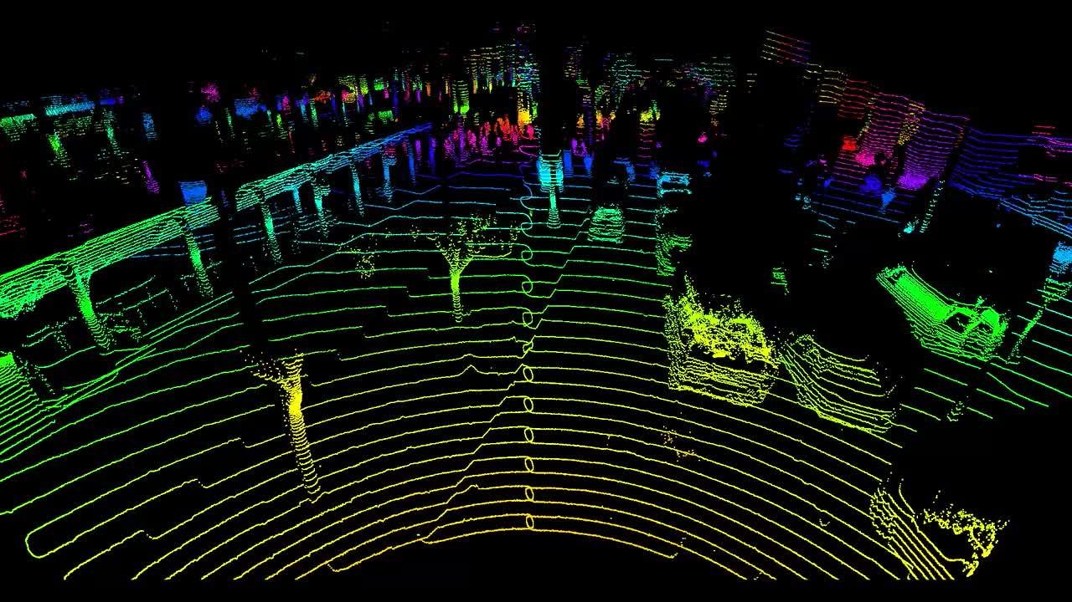
Objectives
Perform object detection on point cloud data using Complex YOLO
Generate a single birds' eye view and 2D point map of point cloud data and use as input to the YOLO network
Evaluate on KITTI dataset and additionally test on data collected from LIDAR setup
Evaluate the possibility of using a low cost 2D LIDAR as an alternate to 3D LIDAR

Slide 3
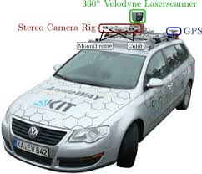
Complex YOLO: Implementation Details
Each row of the file is one object and contains 15 values , including the tag
2D bounding boxes -pixels in the camera image
3D bounding boxes are in 2 co-ordinates
KITTI Dataset
3 classes: Car, Cyclist, Pedestrian
7,481 samples for training including annotated ground truth
85% for training and 15% for validation
camera_2
label (.txt)
3D LIDAR points (.bin)
COMPLEX
YOLO
2d Bounding box
6 matrices :
P03, R0_rect, Tr_velo_to_cam, and Tr_imu_to_velo
calibration (.txt)

Slide 4
Converting between coordinates systems

Slide 5
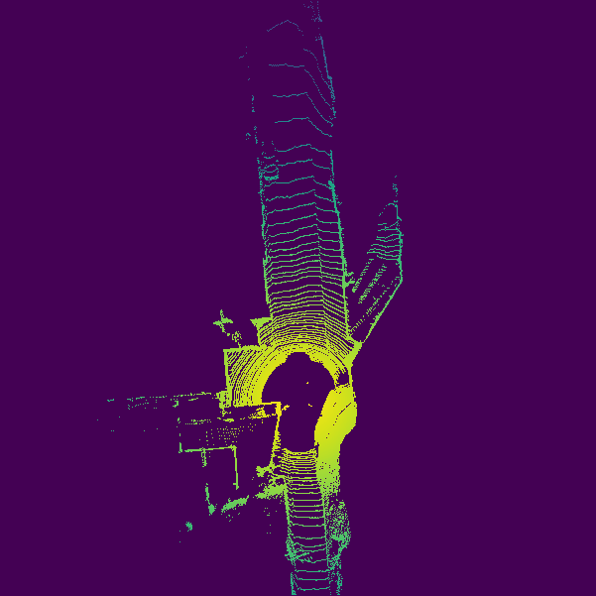
COMPLEX YOLO
E-RPN
Parses the 3D position, object dimensions, probability, class scores p1...pn, orientation from the incoming feature map
Five boxes per grid cell Regression parameters t and object scores p with a general probability p0 and n class scores p1...pn
512

Slide 6
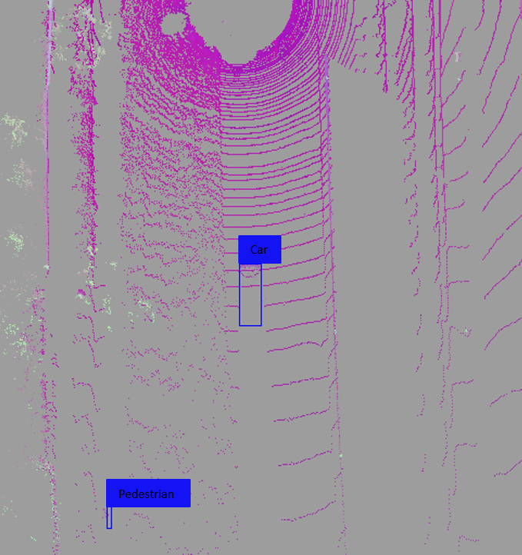
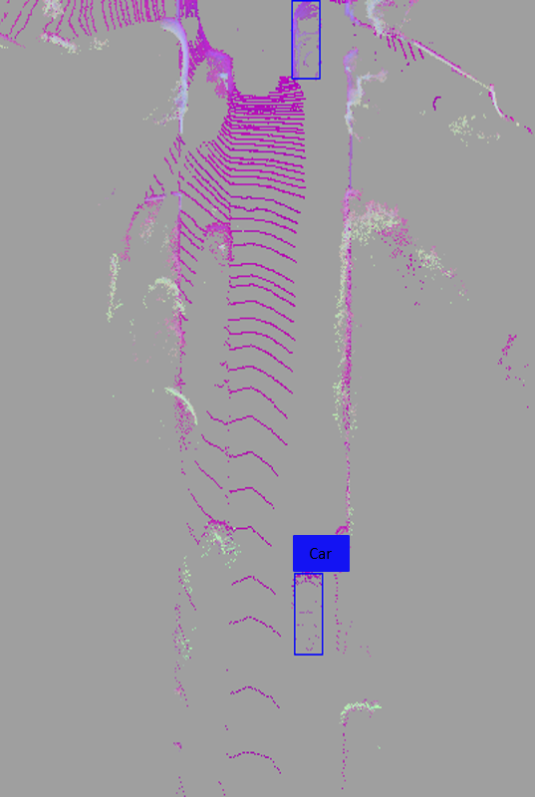
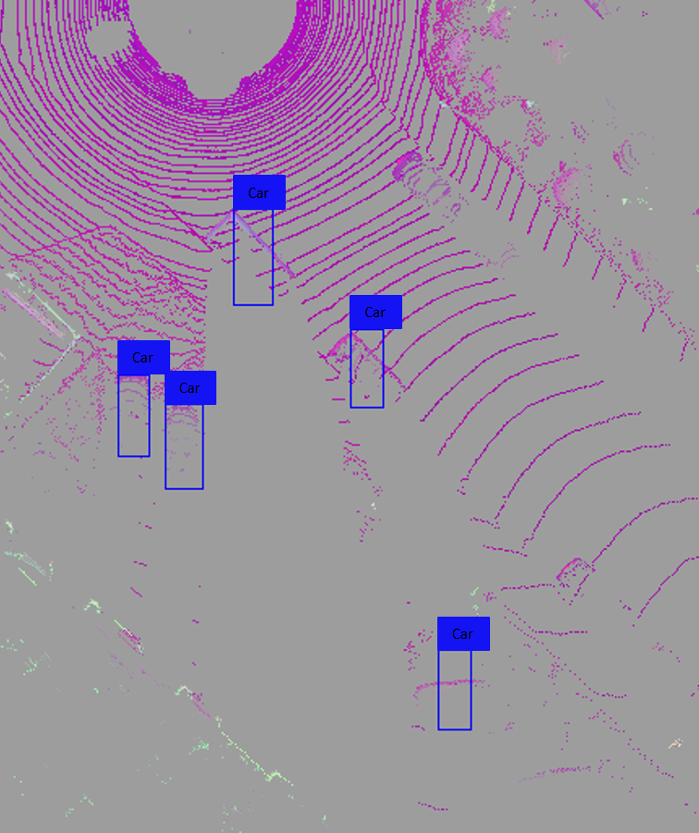
Results of object detection performed on Bird’s eye view

Slide 7
Results of object detection performed on Panorama view

Slide 8
EVALUATION ON KITTI
KITTI Dataset : 85% training, 15% testing
IoU thresholds : 0.7 for class Car, 0.5 for class Pedestrian and Cyclist
Metric for comparison: Mean Average precision (AP)
It is the average of the maximum precisions at different recall values
METHOD | CAR | PEDESTRIAN | CYCLIST
Birds eye view | 61.21 | 25.92 | 34.84
Panorama | 40.5 | - | -

Slide 9
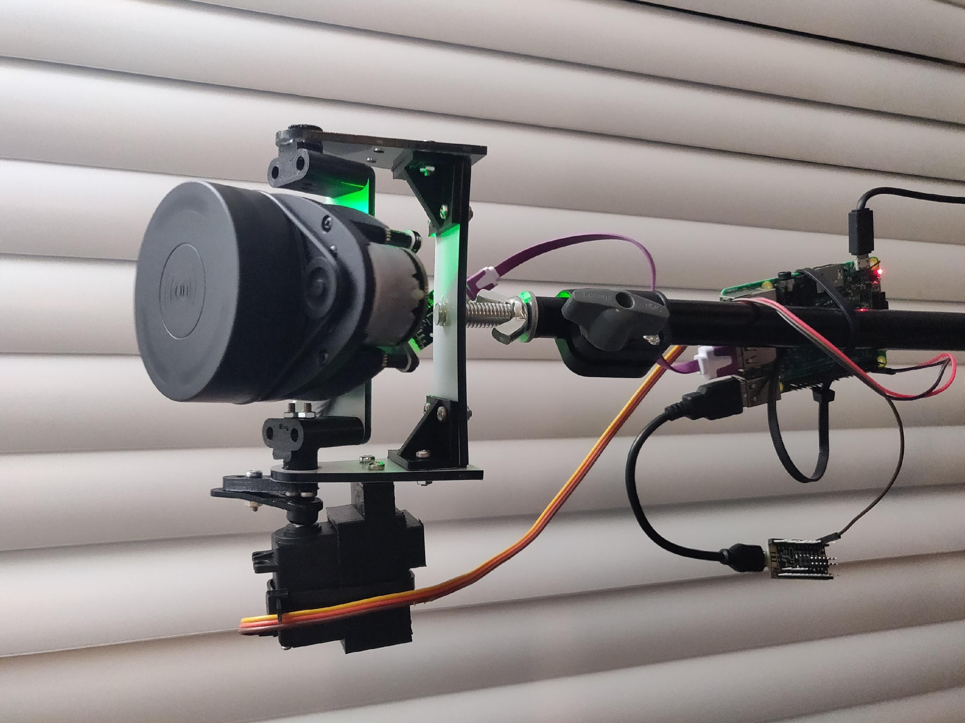
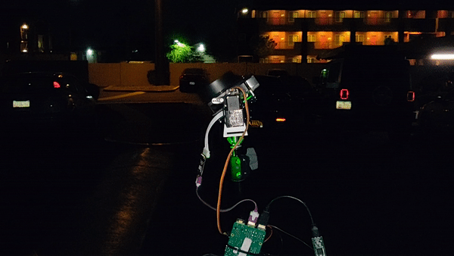
2D LIDAR SETUP
Azimuth angle (Φ)
2D lidar
Elevation (Θ)
Servo
motor
Raspberry
pi
Teensy

Slide 10
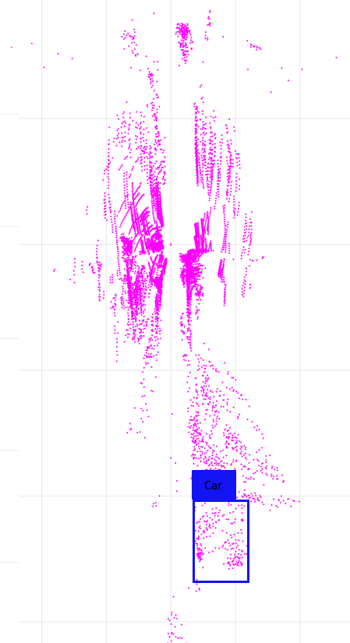
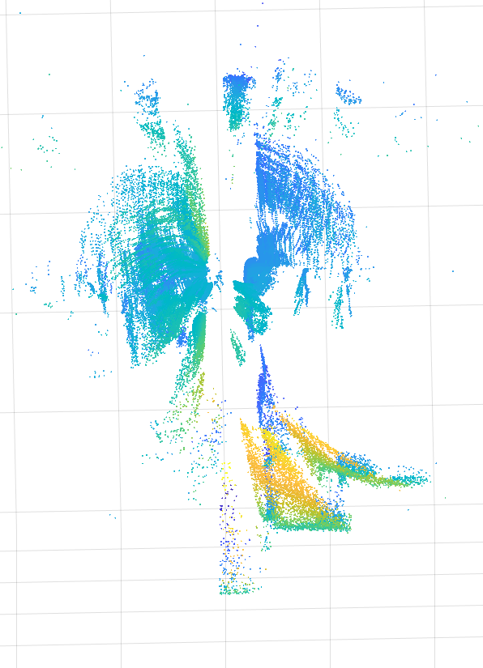
RESULTS FROM 2D LIDAR SETUP
 | 2D LIDAR | VELODYNE HDL 64E (top end)
Range | 6m | 120m
Points per Second | ~500 | ~2.2 Million
Cost | $ 99 | $ 100,000 (approx)

Slide 11
References
[1] M. Simon, S. Milz, K. Amende, and H.-M. Gross, “Complex-yolo: Real-time 3d object detection on point clouds, arXiv preprint arXiv:1803.06199, 2018
[2] Zhou, Y., Tuzel, O.: Voxelnet: End-to-end learning for point cloud based 3d object detection. CoRR abs/1711.06396 (2017)
[3] Qi, C.R., Liu, W., Wu, C., Su, H., Guibas, L.J.: Frustum pointnets for 3d object detection from RGB-D data. CoRR abs/1711.08488 (2017)
[4] Li, B.: 3d fully convolutional network for vehicle detection in point cloud. CoRR abs/1611.08069 (2016)

