Slide 1
Voice Converter Using DeepSpeech and Tacotron
Sreenithy Chandran, Satyajit Giri
Under the supervision of Dr. Visar Berisha
Final Report: EEE 598, Fall 2018

Slide 2
Summary
Proposal
Convert speech from one voice to another with:
no training on input voice
minimal training on output voice
using DeepSpeech, Tacotron and Sprocket
Innovative Claims
Quantized and trimmed Tacotron and DeepSpeech to make them more suitable for deployment.
Created a pipeline to convert input user to text and then back to synthesized speech.
Converted synthesized speech to destination voice through minimal training.
Division of Work
Satyajit: Was in charge of quantizing the models and converting audio files to text.
Sreenithy: Was in charge of converting text to speech and converting synthetic speech to target voice.
Highlighted Results
Reduced models size by 3x
Reproduced expected results for DeepSpeech, Tacotron and Sprocket
Converted Satyajit’s voice to Obama’s voice using only 120 seconds of Obama voice samples

Slide 3
SECTION I: Optimizing Models for Edge Devices

Slide 4
Reducing a Model For Size and Speed
Method | Explanation | Tensorflow Implementation
Trimming | - Remove train only nodes for faster inference | bazel build tensorflow/tools/graph_transforms:transform_graph && \ bazel-bin/tensorflow/tools/graph_transforms/transform_graph \ --in_graph=/tmp/tensorflow_inception_optimized.pb \ --out_graph=/tmp/tensorflow_inception_quantized.pb \ --inputs='Mul:0' --outputs='softmax:0' --transforms='quantize_weights'
Quantization | Reduces the model size while also providing up to 3x lower latency Little degradation in model accuracy quantizes weights to 8-bits of precision from floating-point. | import tensorflow as tf converter = tf.lite.TocoConverter.from_saved_model(saved_model_dir) converter.post_training_quantize = True tflite_quantized_model = converter.convert() open("quantized_model.tflite", "wb").write(tflite_quantized_model)
Memory Mapped | Doesn’t allocates an area of memory on the heap and then copying bytes from disk into it Entire contents of a file appear directly in memory. Speeds loading Reduces paging (increases performance) Does not count towards RAM budget for your app | tensorflow::SessionOptions options; options.config.mutable_graph_options() ->mutable_optimizer_options() ->set_opt_level(::tensorflow::OptimizerOptions::L0); options.env = memmapped_env->get(); tensorflow::Session* session_pointer = nullptr; tensorflow::Status session_status = tensorflow::NewSession(options, &session_pointer);

Slide 5
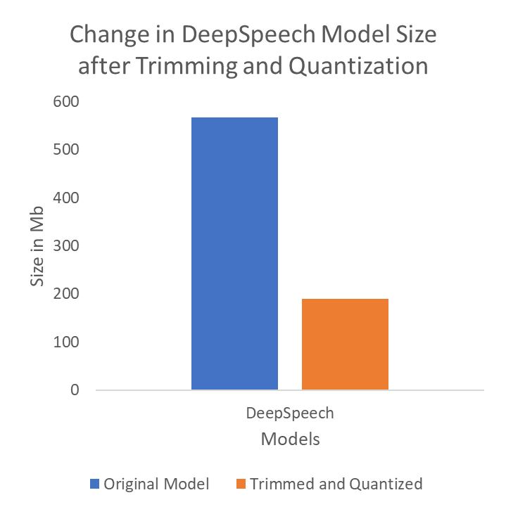
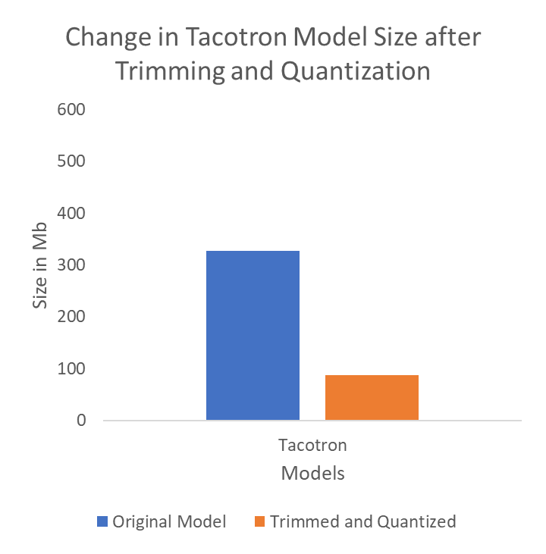
Model Size Decreased when Quantized and Trimmed with TensorflowLite

Slide 6
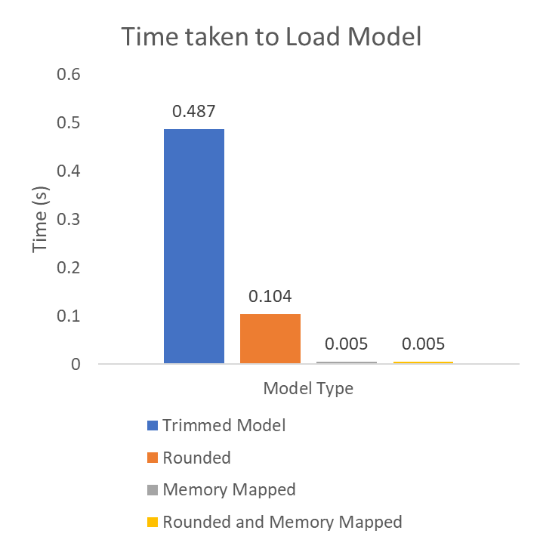
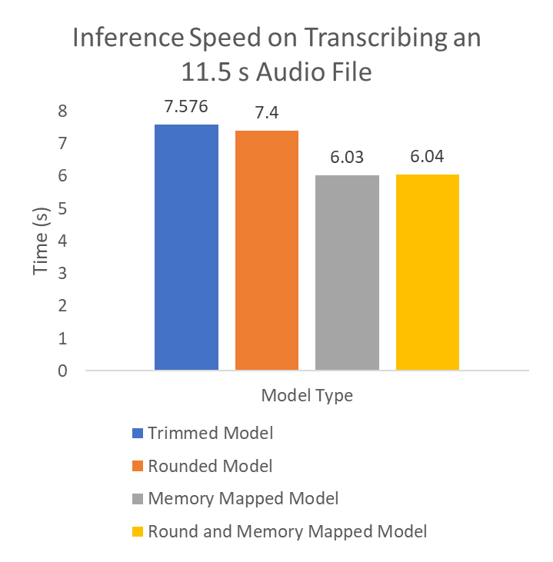
Model Speed Increased after Memory Mapping the Model with TensorflowLite

Slide 7
SECTION II: DeepSpeech (End to End Speech Synthesis)

Slide 8
DeepSpeech tried to replace a multistage recognition pipeline
Acoustic Model
Feature Extractor
Phoneme Prediction
Phoneme Prediction
Phoneme Model
Language Model
Output
Disadvantages:
Requires a lot of specialization.
Not robust to noise
Not robust to speaker changes
Proposal:
Leverage large amounts of data available.
Create an End to End System for Speech Recognition

Slide 9
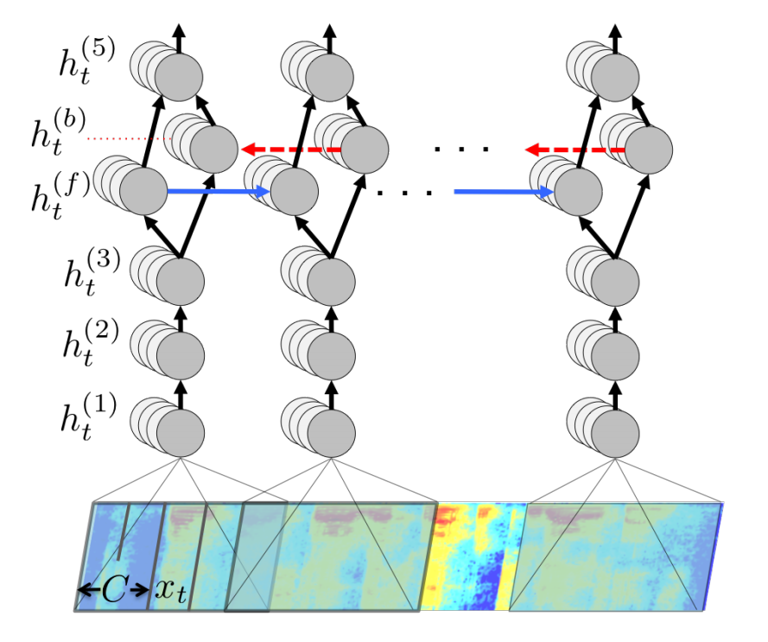
DeepSpeech uses BRNNs to understand relationships between frame-level features
Figure: Structure of DeepSpeech Network

Slide 10
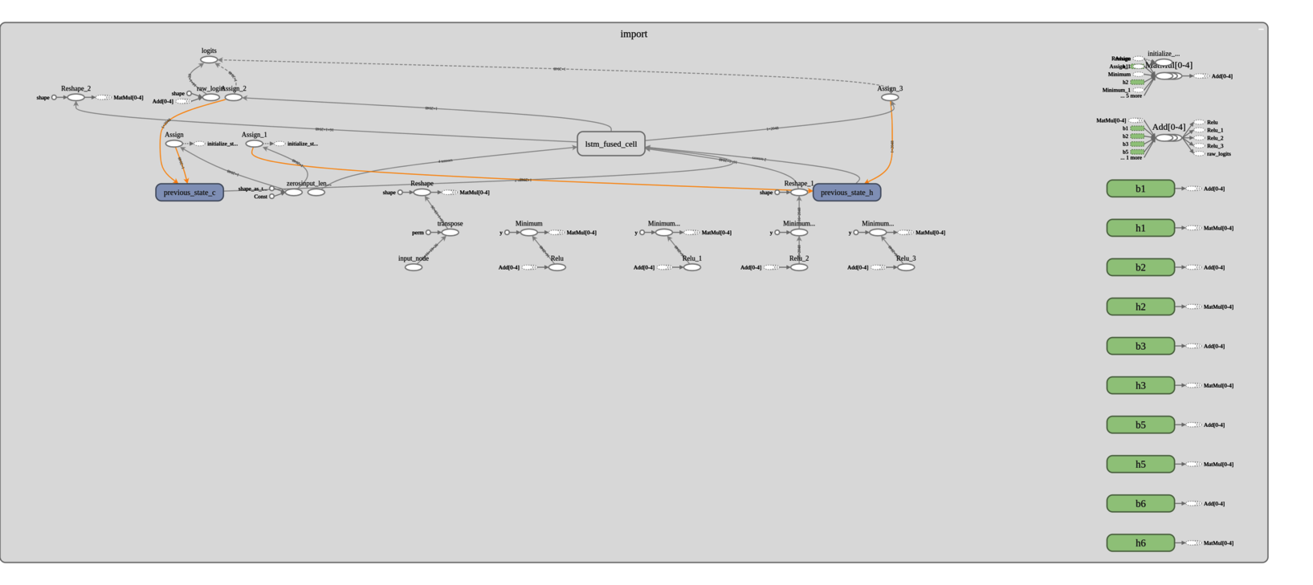
DEEP SPEECH MODEL VISUALIZATION
DeepSpeech model visualization on Tensorboard

Slide 11
Our outputs from DeepSpeech
Output:
“I love trump.”
Output:
“She sells seashells on the seashore”

Slide 12
SECTION III: Tacotron (End to End Speech Synthesis)

Slide 13
Text to Speech Synthesis
Statistical parametric TTS
Text frontend extracting various linguistic features,
Duration model
Acoustic feature prediction model
Complex signal-processing-based vocoder
Disadvantages
Large-scale inverse problem
Each model trained independently-errors compund
Laborious feature engineering
Need for end to end TTS

Slide 14
Datasets Used for Training Tacotron:
Set 1 (LJ Speech Dataset):
13,100 short audio clips of a single speaker
Clips vary in length from 1 to 10 seconds
Set 2 (Blizzard 2012 Dataset):
speaker is Nancy Krebs, who is a professional voice coach. She has a US English accent.
16k prompts in wave file format

Slide 15
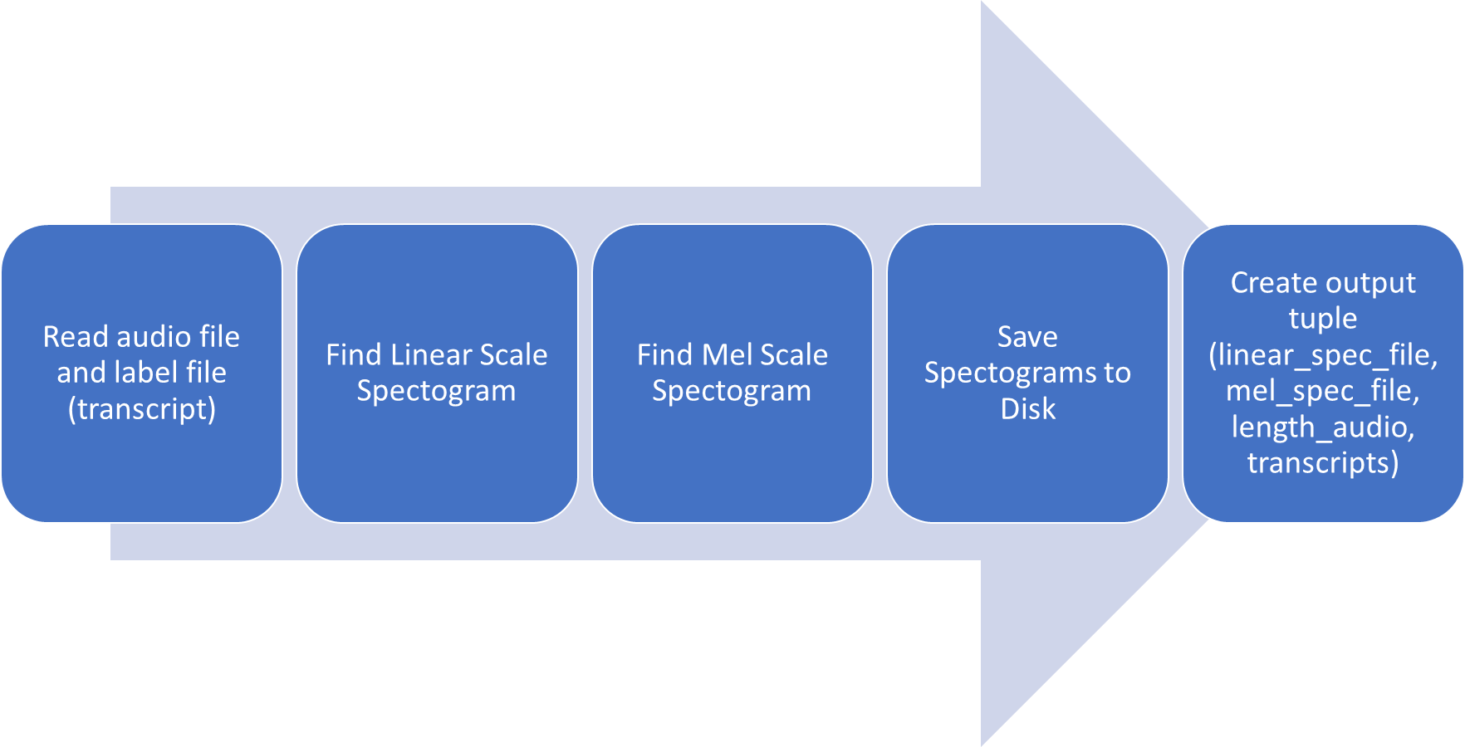
Preprocessing for Tacotron Training

Slide 16
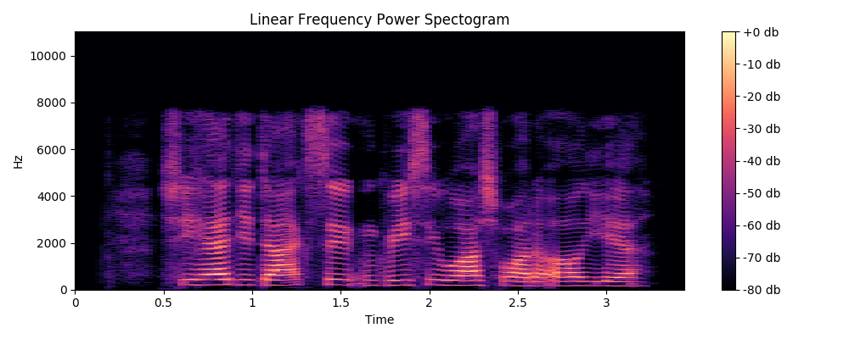
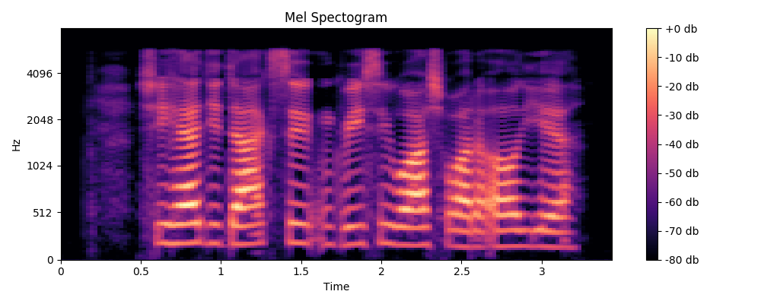
Preprocessing for Tacotron training

Slide 17
Tacotron Flow Chart
TACOTRON
Griffin-Lim reconstruction
CHARACTERS
SPECTOGRAM
WAVEFORM
CBHG
ENCODER
DECODER

Slide 18
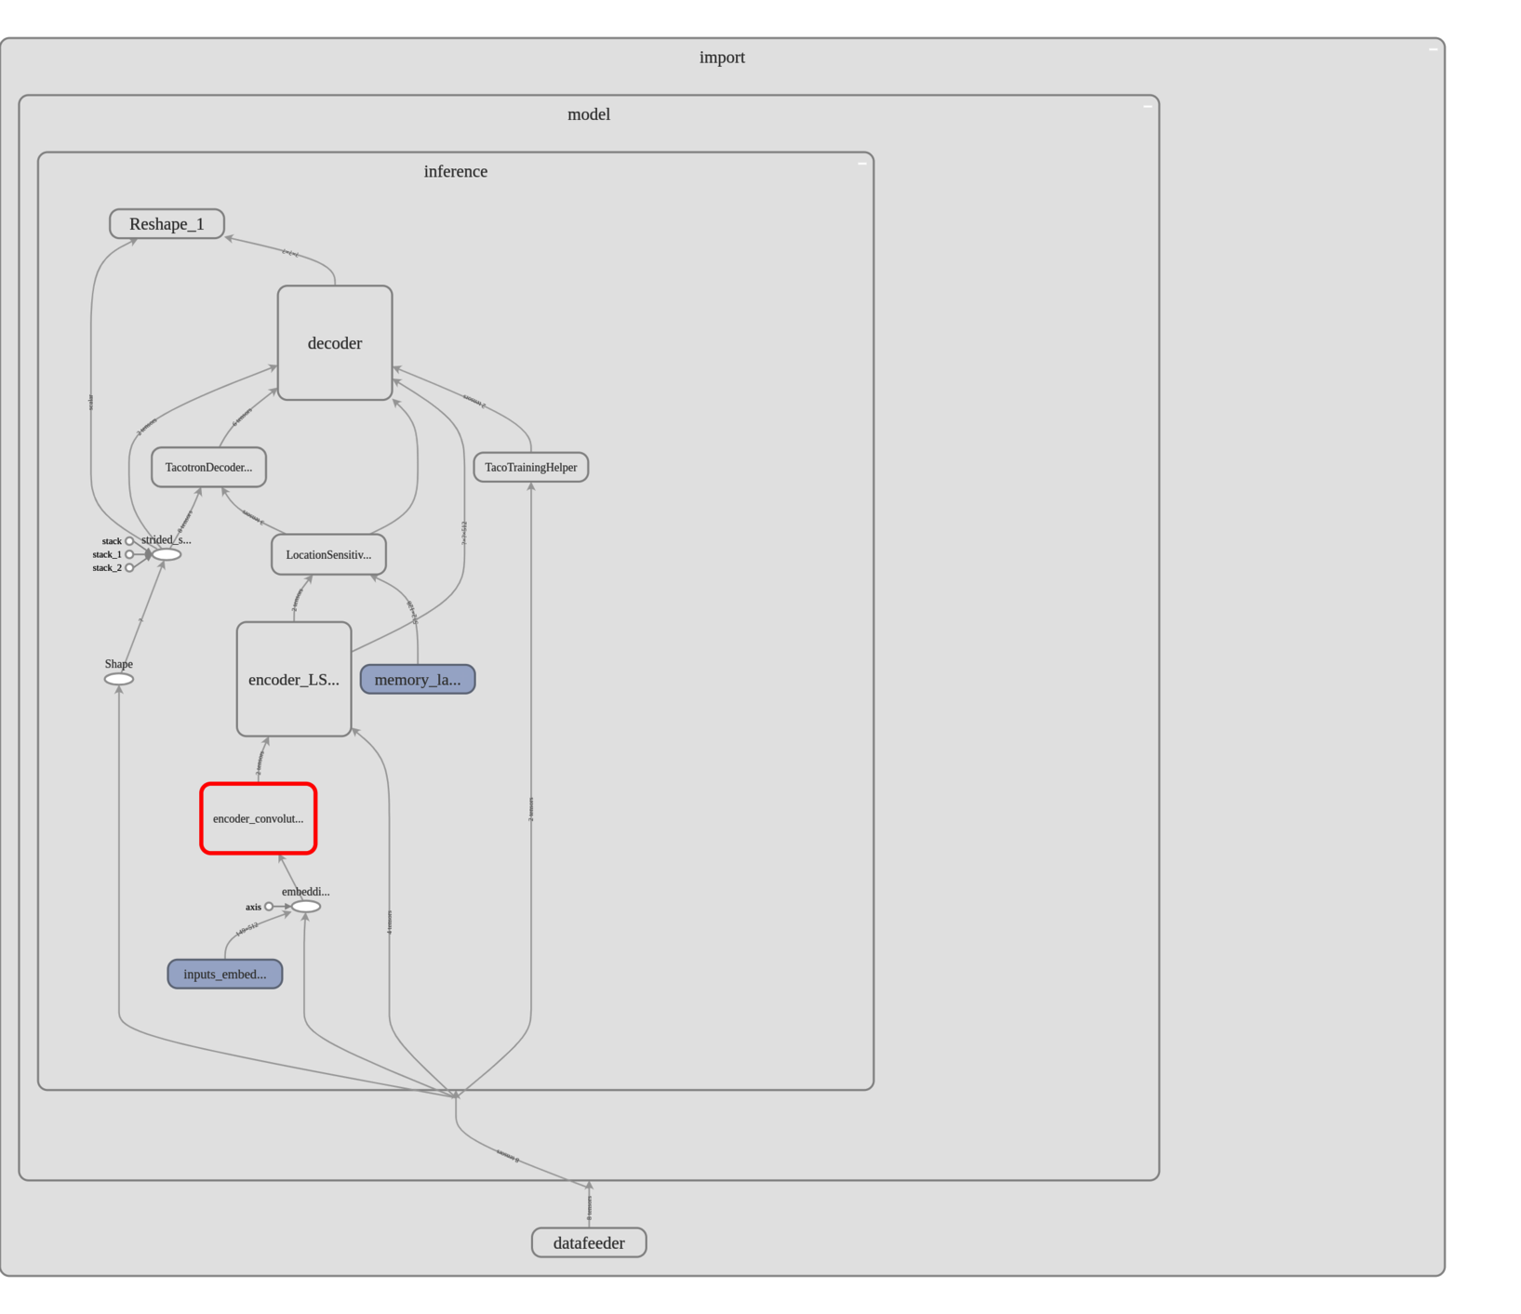
TACOTRON MODEL VISUALIZATION
Tacotron model visualization on Tensorboard

Slide 19
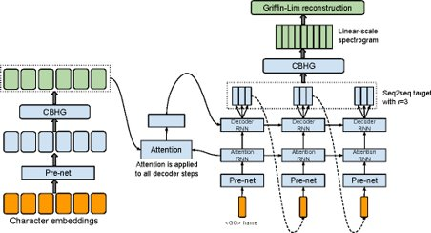
Tacotron model architecture and sample outputs
I was eating pie when the rainbow appeared
She sells sea shells on the sea shore
Mr. and Mrs. Dursley of number four Privet Drive were proud to say that they were perfectly normal, thank you very much. They were the last people you'd expect to be involved in anything strange or mysterious because they just didn't hold with such nonsense

Slide 20
SECTION IV: Voice Conversion

Slide 21
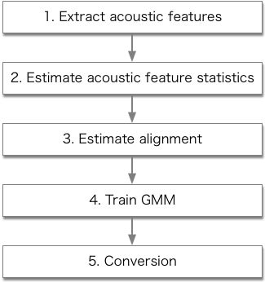
Voice Conversion
Statistical Voice Conversion-convert specific non- or paralinguistic information while keeping linguistic information unchanged
To convert source to target - Several acoustic features such as F0 , aperiodicity, and the melcepstrum
The GMM-based VC method includes:
MLPG considering the GV based on the GMM
Vocoder-free VC using the DIFFVC

Slide 22
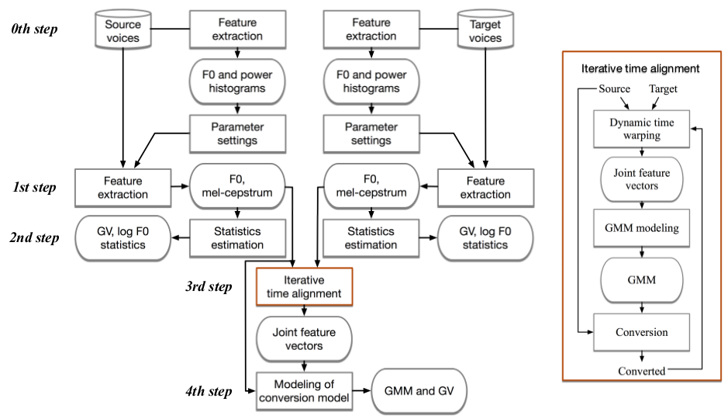
Training process of the GMM-based VC method using a parallel dataset

Slide 23
Results on training GMM (Sprocket) on Obama Voice Samples
Downloaded, cleaned and cropped approximately 2 minutes of Obama’s voice.
Trained the GMM on Obama’s voice and Tacotron’s voice.
Sample Results:
“In developing a strong set of
policies to respond to this crisis
that we discussed”
“That invests in immediate efforts
to create jobs and provide relief”
“For workers who cannot find
work in the increasingly
weak economy”

Slide 24
SECTION V: Final Pipeline

Slide 25
Demonstrating Final Pipeline
Output:
“I love trump.”
Final Voice
Conversion Output
Input Voice
DeepSpeech Output
Tacotron Output

Slide 26
References
[1] K. Kobayashi, T. Toda, S. Nakamura, "F0 transformation techniques for statistical voice conversion with direct waveform modification with spectral differential," Proc. IEEE SLT, pp. 693-700, Dec. 2016
[2] A. Hannun, C. Case, J. Casper, B. Catanzaro, G. Diamos, E. Elsen, R. Prenger, S. Satheesh, S. Sengupta, A. Coates, A. Y. Ng., ``Deep Speech: Scaling up end-to-endspeech recognition", arXiv:1412.5567v2 [cs.CL] 19 Dec 2014
[3] A.G. Howard, M. Zhu, B. Chen, D. Kalenichenko, W. Wang, T. Weyand, M. Andreetto, H. Adam,``MobileNets: Efficient Convolutional Neural Networks for Mobile Vision Applications," Computer Vision and Pattern Recognition, 17 Apr 2017.
[4] K. R. Krishnamoorthi, ``Quantizing deep convolutional networks for efficient inference: A whitepaper," arXiv:1806.08342v1
[5] Y. Wang, R. Skerry-Ryan, D. Stanton, Y. Wu, R. J. Weiss,N. Jaitly, Z. Yang, Y. Xiao, Z. Chen, S. Bengio, Q. Le,Y. Agiomyrgiannakis, R. Clark, and R. A. Saurous, “Tacotron:Towards end-to-end speech synthesis,” in Proc. Interspeech,Aug. 2017, pp. 4006–4010.
[6] https://github.com/keithito/tacotron
[7] https://github.com/k2kobayashi/sprocket
[8] https://github.com/mozilla/DeepSpeech

